Slide 1

GAN: DCGAN, CycleGAN, SRGAN / ESRGAN
Group 22 and 23

Slide 2
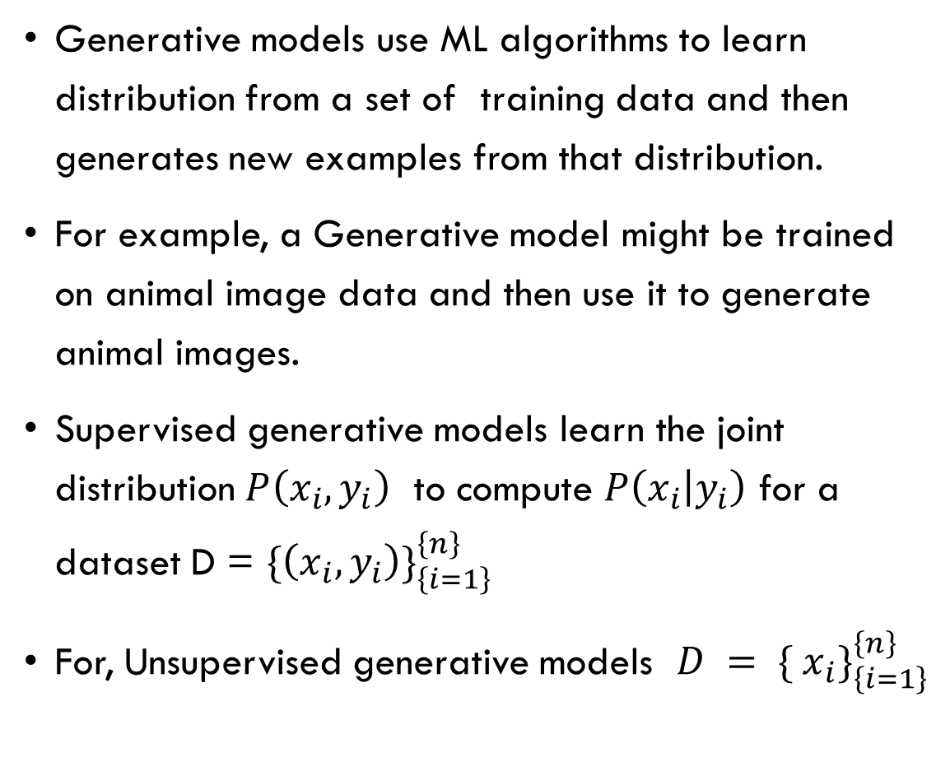
Generative Models
Generative models use ML algorithms to learn distribution from a set of training data and then generates new examples from that distribution.
For example, a Generative model might be trained on animal image data and then use it to generate animal images.
Supervised generative models learn the joint distribution $P\left(x_{i},y_{i}\right)$ to compute $P\left(x_{i} | y_{i}\right)$ for a dataset D = $\{\left(x_{i}, y_{i}\right)\}_{\left\{i=1\right\}}^{\left\{n\right\}}$
For, Unsupervised generative models $D = \{ x_{i}\}_{\left\{i=1\right\}}^{\left\{n\right\}}$

Slide 3
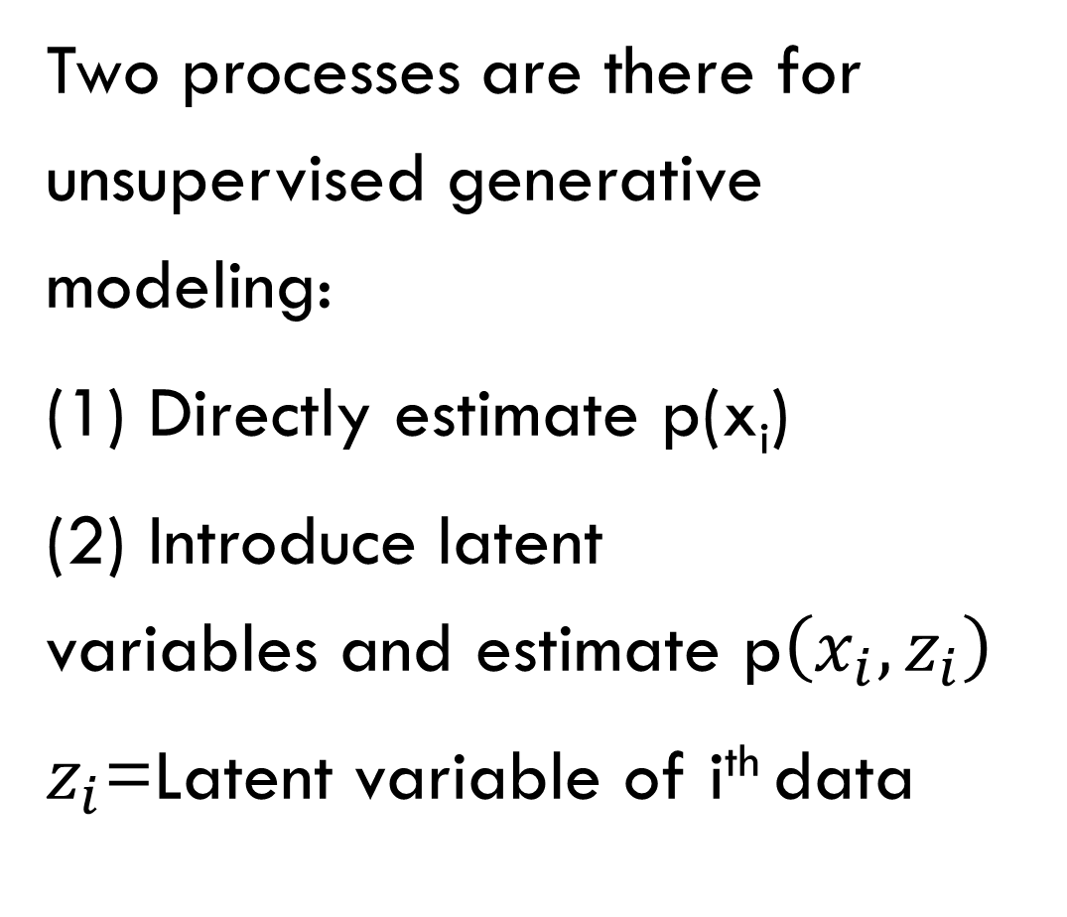
Generative Models(Cont.)
Two processes are there for unsupervised generative modeling:
(1) Directly estimate p(x_{i})
(2) Introduce latent variables and estimate p$\left(x_{i},z_{i}\right)$
$z_{i}$=Latent variable of i^{th} data

Slide 4
Latent Variable and Latent Space
A latent variable is something that is hidden but important.
e.g., age, mood, head angle — we don’t see these in a face image, but these hidden things affect the face image. These things are latent variables.
Latent space is a map of all possible latent variables i.e., every point represents a hidden description of a data sample, similar points make similar data.
e.g., smile → no smile, rotate head left → right, old → young.

Slide 5
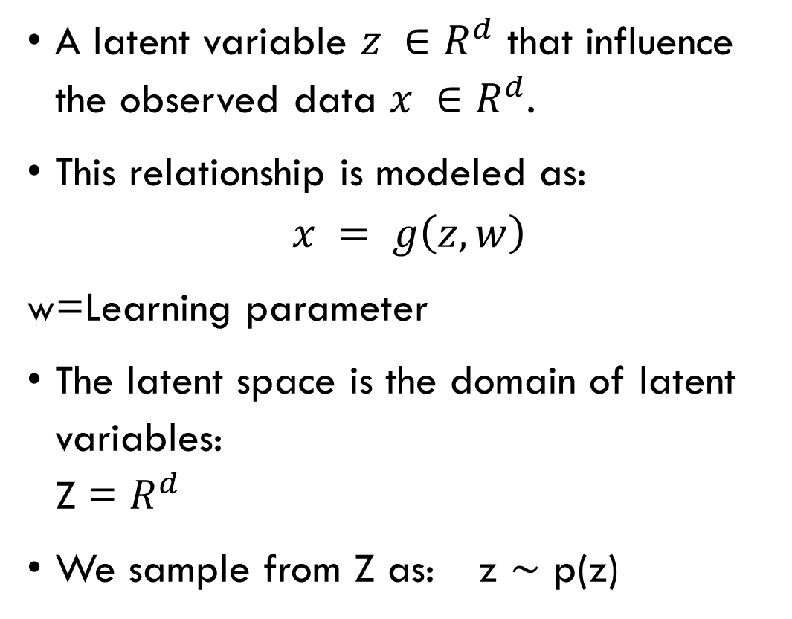
Latent Variable and Latent Space (Cont.)
A latent variable $z ∈R^{d}$ that influence the observed data $x ∈R^{d}$.
This relationship is modeled as:
$$x = g\left(z, w\right)$$
w=Learning parameter
The latent space is the domain of latent variables: Z = $R^{d}$
We sample from Z as: z ∼ p(z)

Slide 6
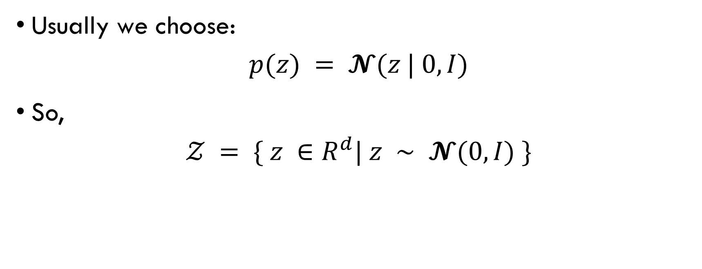
Latent Variable and Latent Space (Cont.)
Usually we choose:
$$p(z) = 𝓝(z | 0, I)$$
So,
$$𝒵 = \{ z ∈R^{d}| z ∼ 𝓝(0, I) \}$$

Slide 7
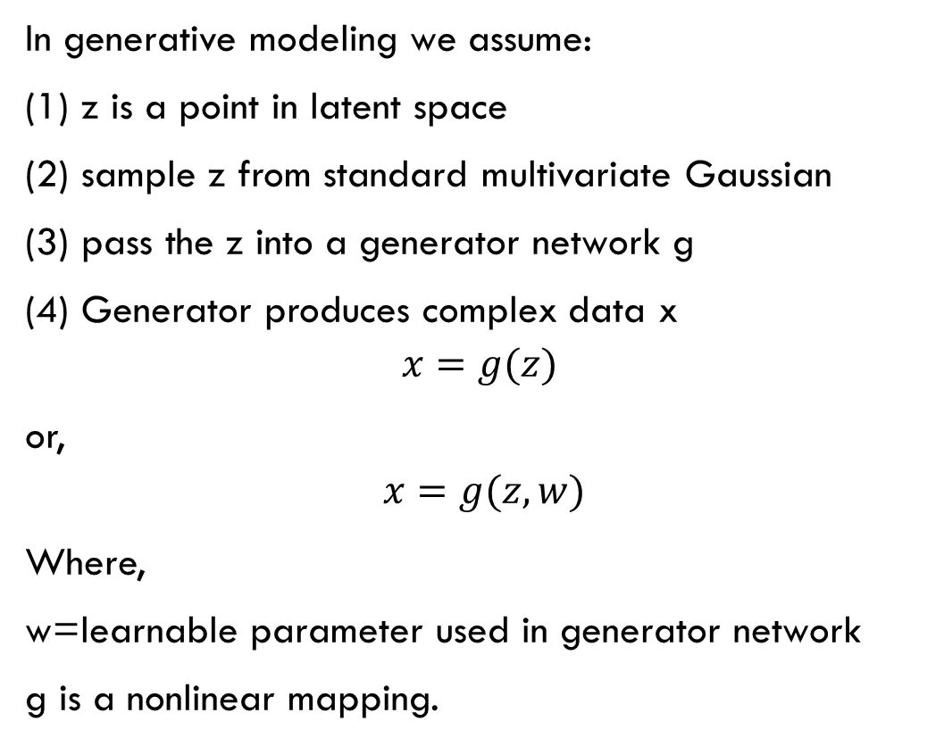
Latent Variable and Latent Space (Cont.)
In generative modeling we assume:
(1) z is a point in latent space
(2) sample z from standard multivariate Gaussian
(3) pass the z into a generator network g
(4) Generator produces complex data x
$$x=g(z)$$
or,
$$x=g(z,w)$$
Where,
w=learnable parameter used in generator network
g is a nonlinear mapping.

Slide 8
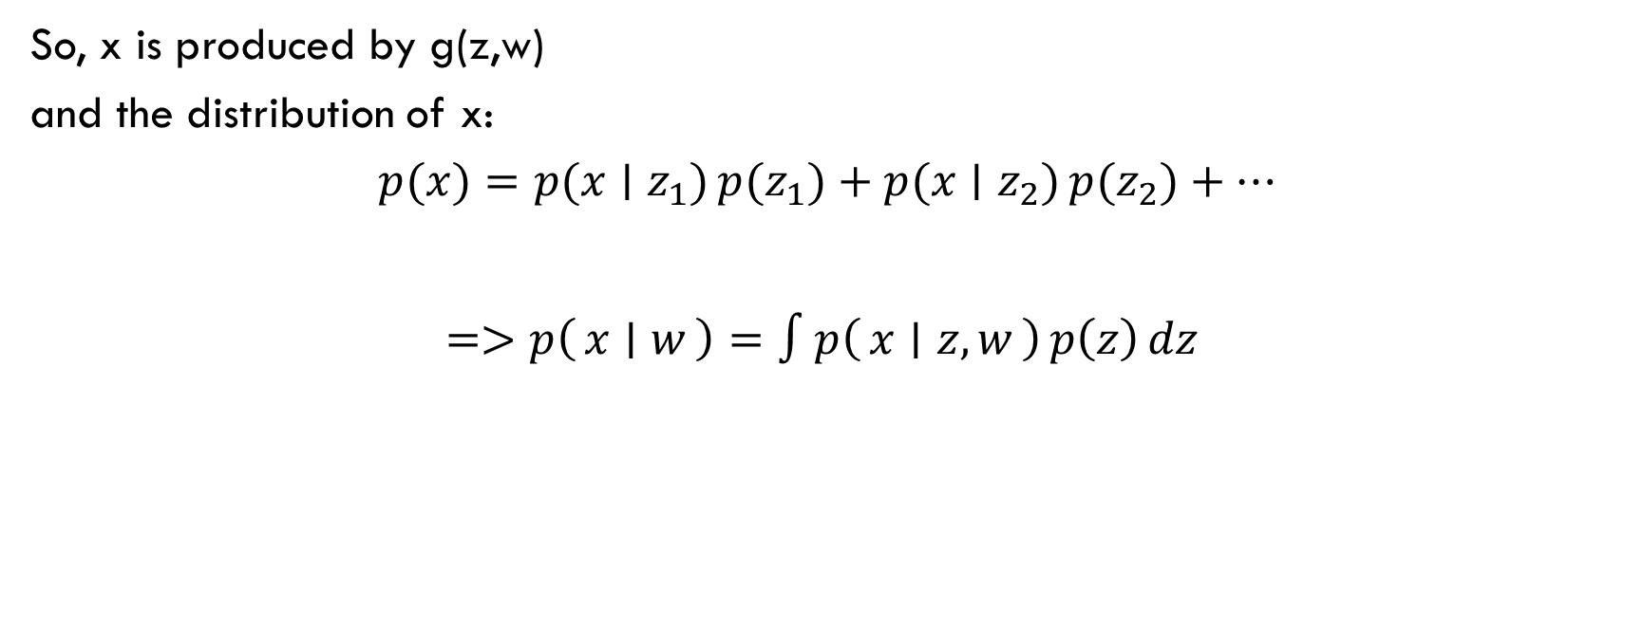
Latent Variable and Latent Space (Cont.)
So, x is produced by g(z,w) and the distribution of x:
$$p(x)=p(x∣z_{1}) p(z_{1})+p(x∣z_{2}) p(z_{2})+…$$
$$=>p\left(x ∣ w\right)=∫p\left(x ∣ z,w\right) p\left(z\right) dz$$

Slide 9
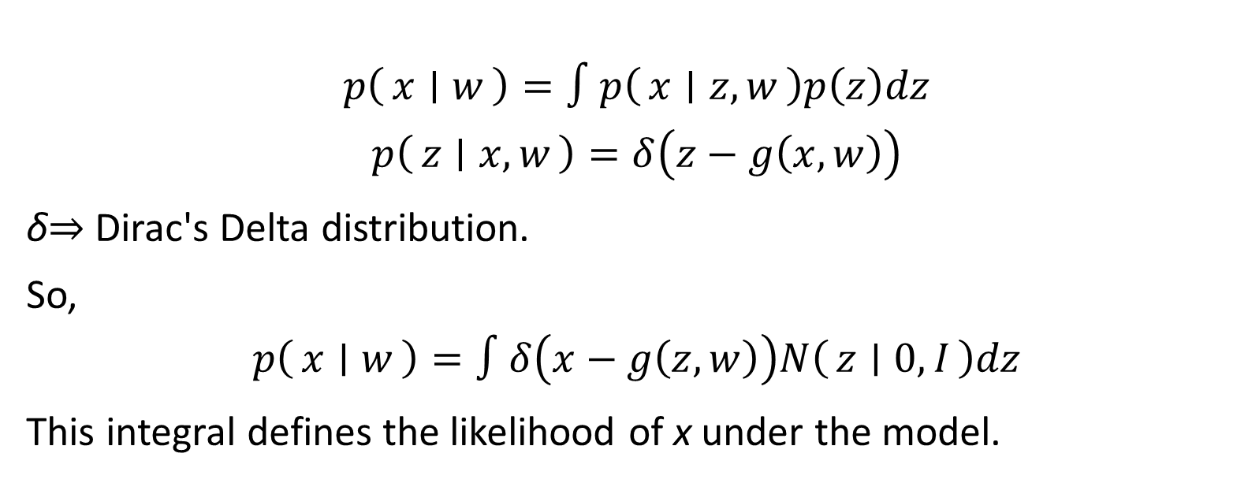
Why we can not compute Likelihood
$$p\left(x ∣ w\right)=∫p\left(x ∣ z,w\right)p\left(z\right)dz$$
$$p\left(z ∣ x,w\right)=δ\left(z−g\left(x,w\right)\right)$$
δ⇒ Dirac's Delta distribution.
So,
$$p\left(x ∣ w\right)=∫δ\left(x−g\left(z,w\right)\right)N\left(z ∣ 0,I\right)dz$$
This integral defines the likelihood of x under the model.

Slide 10
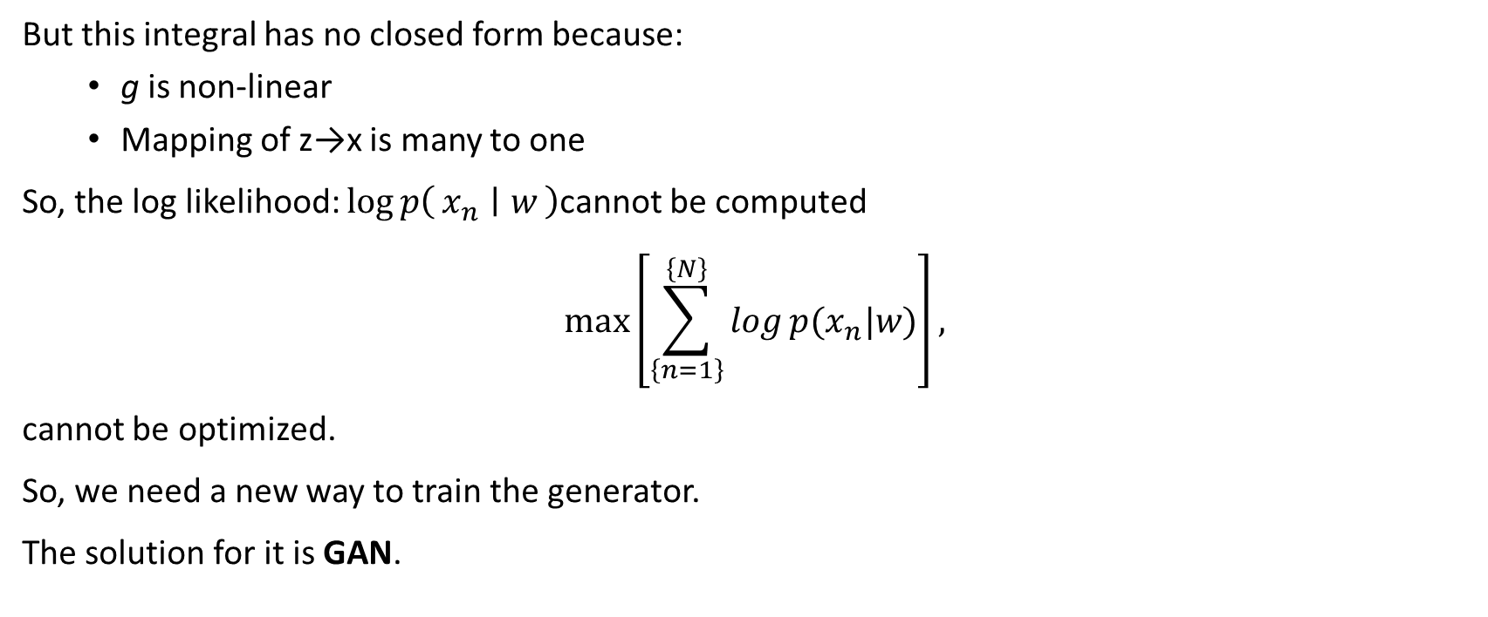
Why we can not compute Likelihood
But this integral has no closed form because:
g is non-linear
Mapping of z→x is many to one
So, the log likelihood: $\log{p\left(x_{n} ∣ w\right)}$cannot be computed
$$\max\left[\sum_{\left\{n=1\right\}}^{\left\{N\right\}}{log}{p(x_{n}|w)}\right],$$
cannot be optimized.
So, we need a new way to train the generator.
The solution for it is GAN.

Slide 11
GAN
The idea of GAN is to introduce a second discriminator network which is trained jointly with generator network and which provides a training signal to update the weights of the generator.
The discriminator's job:
Input: a sample x.
Output: probability that x is real or x is fake.
Real → label = 1 Fake → label = 0 This part is supervised and BCE is used

Slide 12
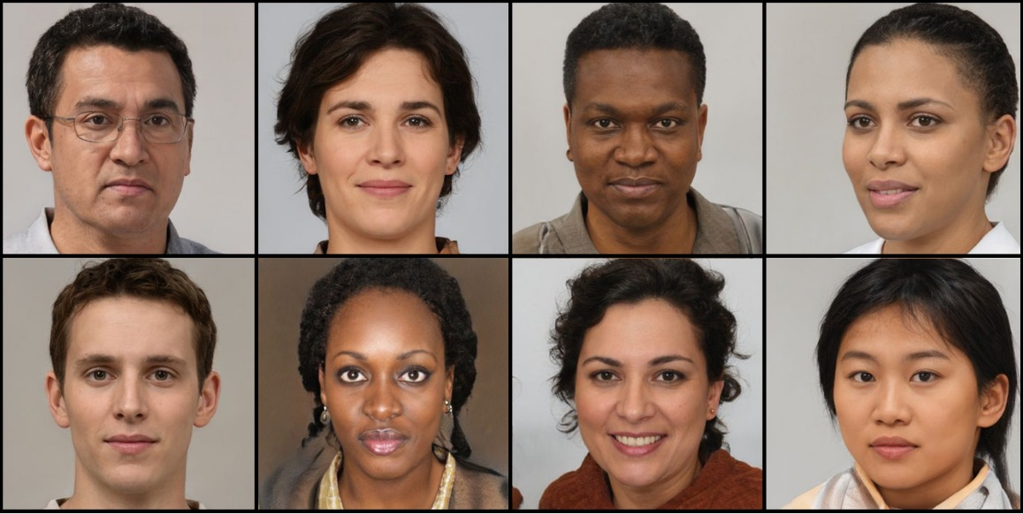
Source: Deep Learning : Foundations and Concepts

Slide 13
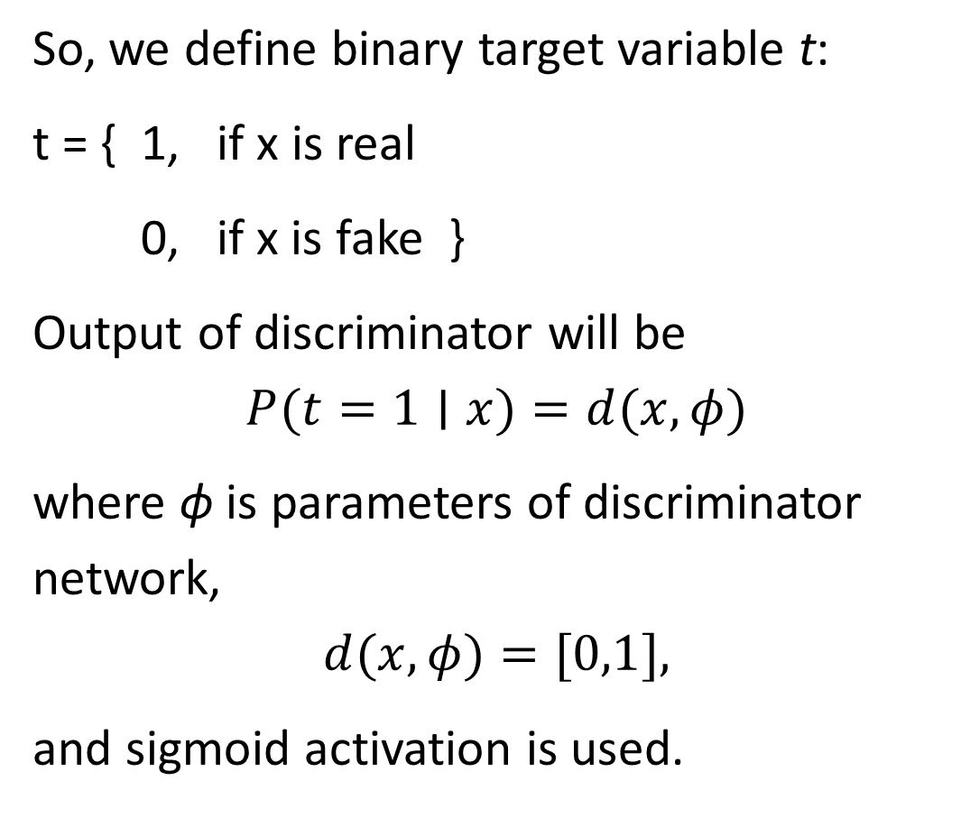
GAN
So, we define binary target variable t:
t = { 1, if x is real
0, if x is fake }
Output of discriminator will be
$$P(t=1∣x)=d(x,φ)$$
where ϕ is parameters of discriminator network,
$$d(x,φ)=[0,1],$$
and sigmoid activation is used.

Slide 14
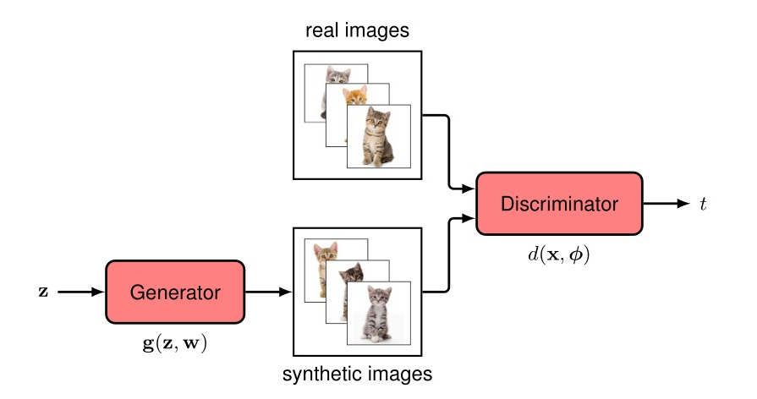
Source: Deep Learning : Foundations and Concepts

Slide 15
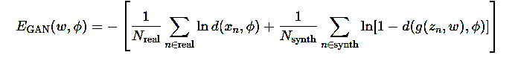
Loss Function(cont.)
Since for real data ⇒ t=1 and fake data ⇒ t=0
Loss becomes:

Slide 16
Loss Function(cont.)
First term: Encourage discriminator to output 1 for real data
Second term: Encourage discriminator to output 0 for fake data

Slide 17
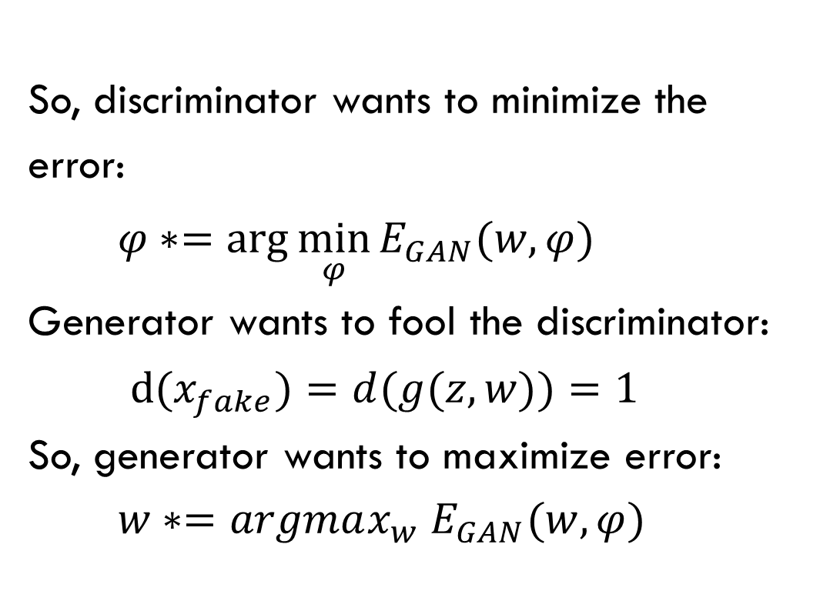
Loss Function(cont.)
So, discriminator wants to minimize the error: $φ∗=arg⁡\min_{φ}⁡E_{GAN}(w,φ)$ Generator wants to fool the discriminator: $d(x_{fake})=d(g(z,w))=1$ So, generator wants to maximize error: $w∗=argmax_{w} E_{GAN}(w,φ)$

Slide 18
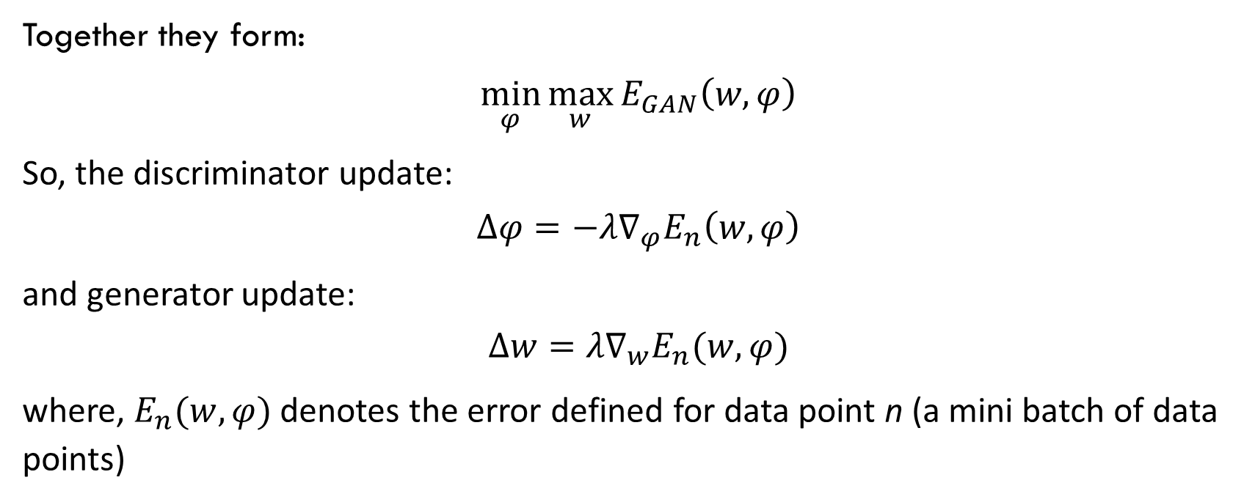
Loss Function(cont.)
Together they form:
$$\min_{φ}{\max_{w}{E_{GAN}\left(w,φ\right)}}$$
So, the discriminator update:
$$Δφ=−λ∇_{φ}E_{n}\left(w,φ\right)$$
and generator update:
$$Δw=λ∇_{w}E_{n}(w,φ)$$
where, $E_{n}(w,φ)$denotes the error defined for data point n (a mini batch of data points)

Slide 19
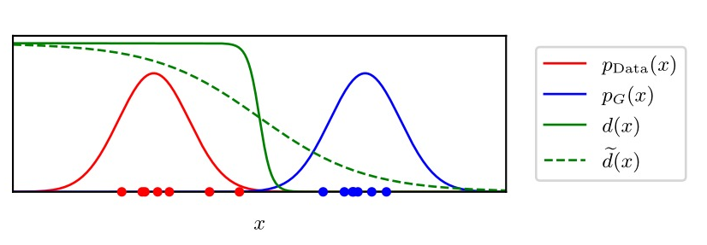
Gan Training
Gan does not minimize a simple error function like regression or classification, instead the training is min-max game between generator and discriminator
Generator tries to fool the discriminator, and discriminator tries to detect fake samples.

Slide 20
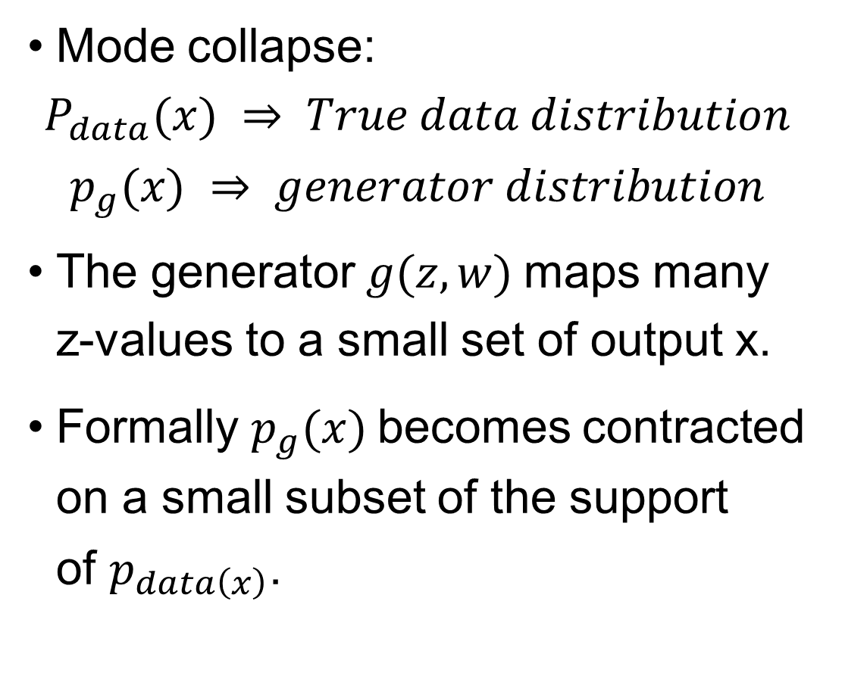
Gan Training
Mode collapse:
$$P_{data}(x) ⇒ True data distribution$$
$$p_{g}(x) ⇒ generator distribution$$
The generator $g(z,w)$maps many z-values to a small set of output x.
Formally $p_{g}(x)$becomes contracted on a small subset of the support of $p_{data\left(x\right)}$.

Slide 21
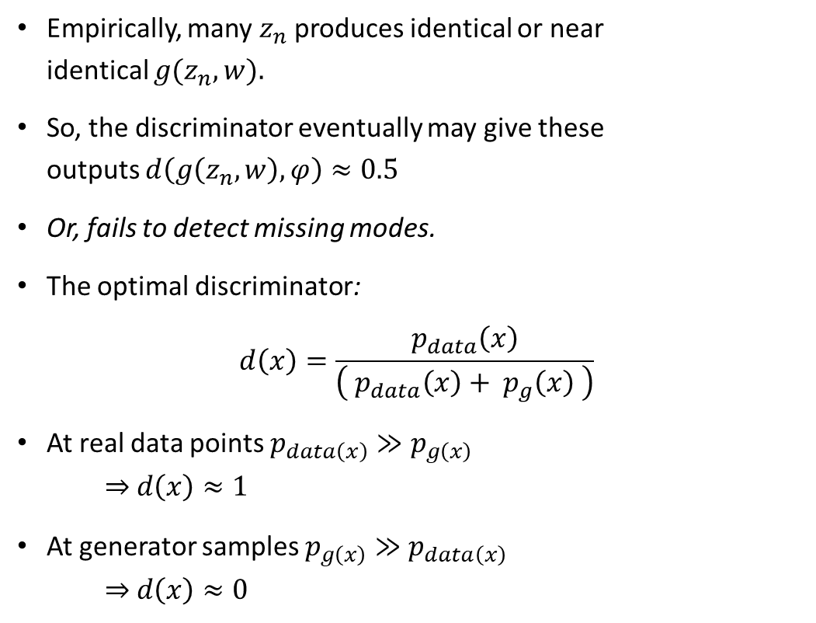
Gan Training(Cont.)
Empirically, many $z_{n}$produces identical or near identical $g(z_{n},w).$
So, the discriminator eventually may give these outputs $d\left(g\left(z_{n},w\right),φ\right)≈0.5$
Or, fails to detect missing modes.
The optimal discriminator:
$$d\left(x\right)=\frac{p_{data}\left(x\right)}{\left( p_{data}\left(x\right)+ p_{g}\left(x\right) \right)}$$
At real data points $p_{data\left(x\right)}≫p_{g\left(x\right)}$ ⇒ $d\left(x\right)≈1$
At generator samples $p_{g\left(x\right)}≫p_{data\left(x\right)}$ ⇒ $d\left(x\right)≈0$

Slide 22
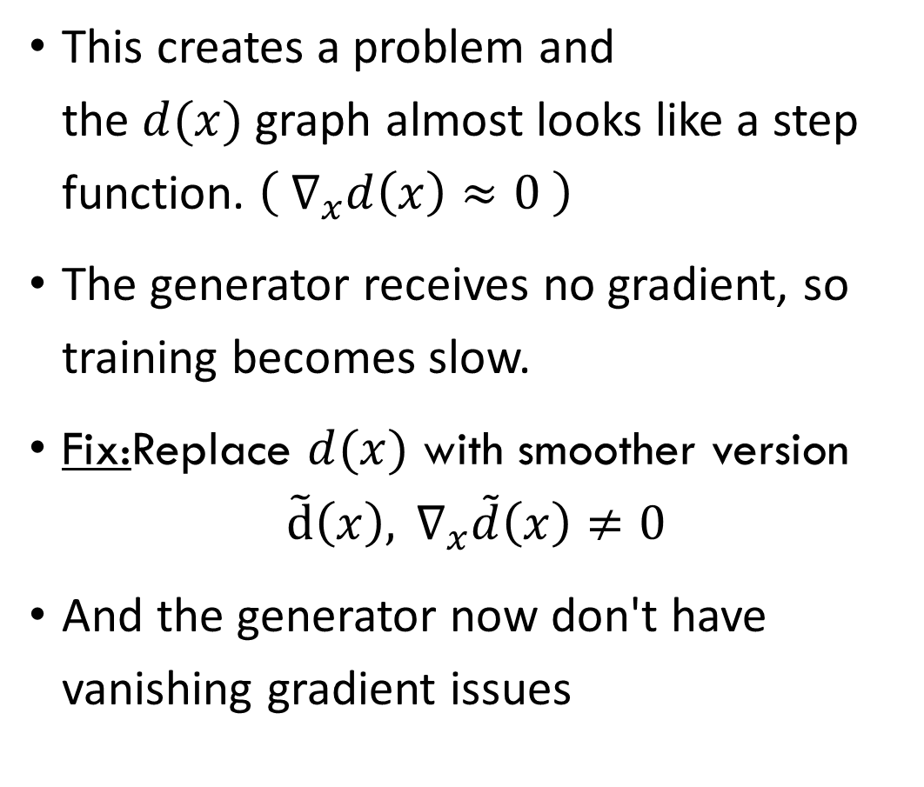
Gan Training(Cont.)
This creates a problem and the $d(x)$graph almost looks like a step function. $\left( ∇_{x}d\left(x\right)≈0 \right)$
The generator receives no gradient, so training becomes slow.
Fix:Replace $d(x)$ with smoother version
$$\tilde{\text{d}}\left(x\right), ∇_{x}\tilde{d}\left(x\right)≠0$$
And the generator now don't have vanishing gradient issues

Slide 23
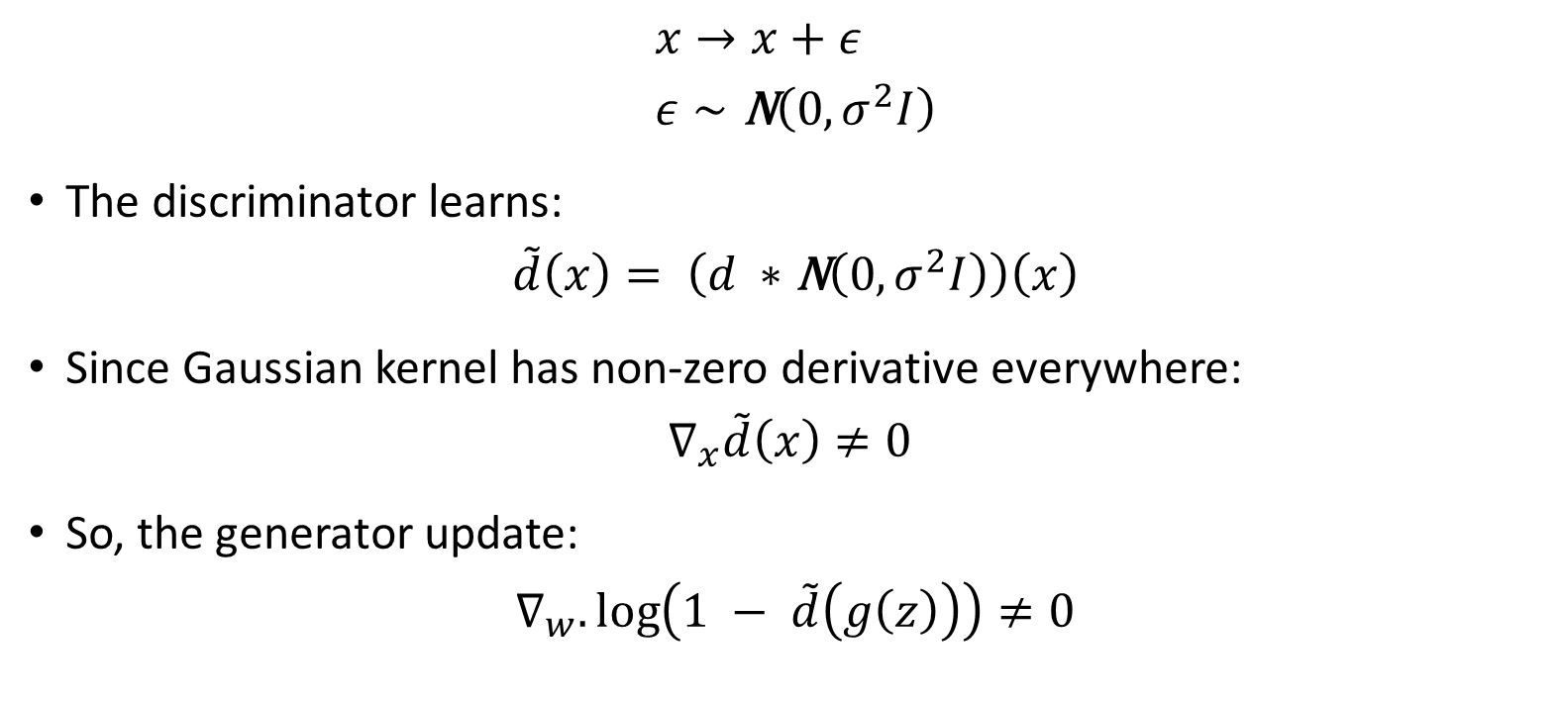
Instance Noise
$$x→x+ε \\ ε∼\text{N}\left(0,σ^{2}I\right)$$
The discriminator learns:
$$\tilde{d}\left(x\right)= \left.\left(d ∗\text{N}\left(0, σ^{2}I\right)\right.\right)\left(x\right)$$
Since Gaussian kernel has non-zero derivative everywhere:
$$∇_{x}\tilde{d}\left(x\right)≠0$$
So, the generator update:
$$∇_{w}.\log\left.\left(1 − \tilde{d}\left(g\left(z\right)\right)\right.\right)≠0$$

Slide 24
What is DCGAN?
Deep Convolutional GAN (DCGAN) is a GAN variant where both the Generator and Discriminator use convolutional neural networks (CNNs) for better image generation and discrimination performance.​
DCGAN is designed for image-related tasks, such as generating realistic-looking photos from random noise vectors.

Slide 25
Motivation & Applications
Uses CNNs to model complex image distributions with high fidelity.
Commonly applied in unsupervised representation learning, face generation, style transfer, and super-resolution.
Mode collapse occurs when the generator produces only a few output types (e.g., only 2–3 MNIST digits), causing the discriminator to also focus on those limited patterns.
DCGANs help reduce mode collapse by providing a more stable convolution-based architecture, enabling the generator to produce diverse outputs.

Slide 26
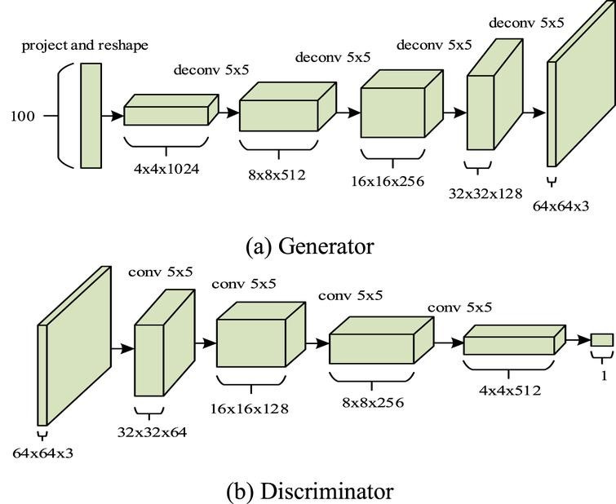
Architecture OF DCGAN

Slide 27
Architecture OF DCGAN (Cont.)
Eliminates fully connected layers in deeper architecture; uses only convolutional and transposed convolutional layers.
Batch Normalization applied in both G & D for training stability.
ReLU activation in G (except output: usually Tanh); LeakyReLU in D.
No pooling or upsampling layers; spatial changes via strided convolutions/transpose convolutions.​

Slide 28
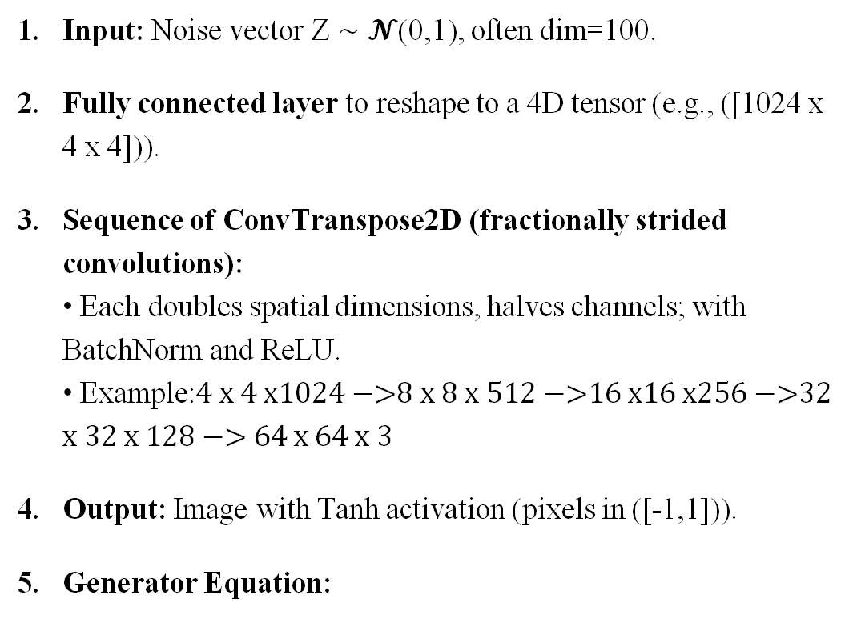
DCGAN Generator Architecture
Input: Noise vector Z ∼ 𝓝(0,1), often dim=100.
Fully connected layer to reshape to a 4D tensor (e.g., ([1024 x 4 x 4])).
Sequence of ConvTranspose2D (fractionally strided convolutions): • Each doubles spatial dimensions, halves channels; with BatchNorm and ReLU. • Example:$\text{4 }\text{x}\text{ 4 }\text{x}\text{1024 }\text{−>}\text{8 }\text{x} \text{8 }\text{x} \text{512 }\text{−>}\text{16 }\text{x}\text{16 }\text{x}\text{256 }\text{−>}\text{32 }\text{x} \text{32 }\text{x}\text{ 128 }\text{−>}\text{ 64 }\text{x}\text{ 64 }\text{x}\text{ 3}$
Output: Image with Tanh activation (pixels in ([-1,1])).
Generator Equation:

Slide 29
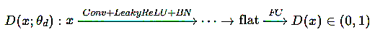
DCGAN Discriminator Architecture
Input: Image (fake or real).
Sequence of Conv2D layers:
Reduce spatial size with stride >1; channels increase at each stage.
Use LeakyReLU activations and BatchNorm.
No pooling layers; no fully connected except final output.
Flatten & linear output: Sigmoid activation for real/fake probability.
Discriminator Equation (symbolic):

Slide 30
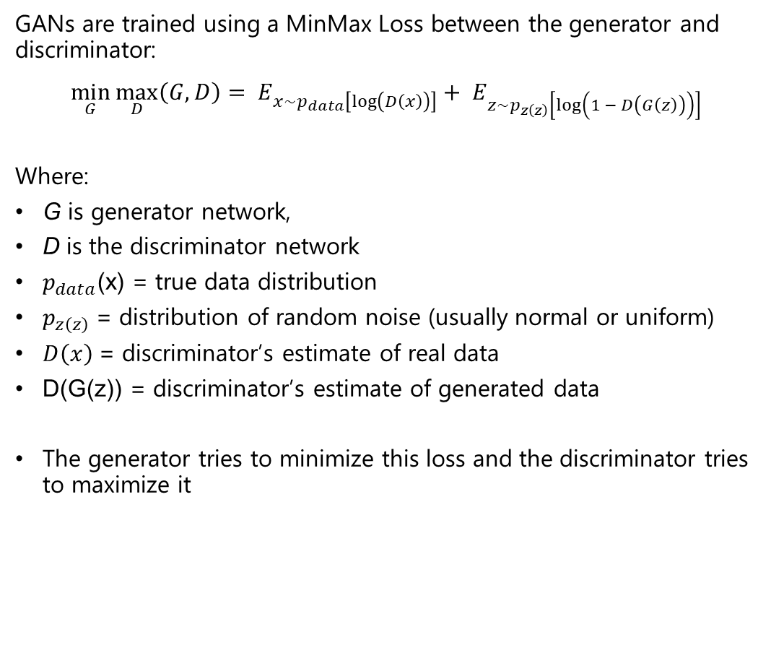
MinMax Loss
GANs are trained using a MinMax Loss between the generator and discriminator:
$$\min_{G}{\max_{D}\left(G, D\right)}= E_{x\sim p_{data}\left[\log\left(D\left(x\right)\right)\right]}+ E_{z\sim p_{z\left(z\right)}\left[\log\left(1 − D\left(G\left(z\right)\right)\right)\right]}$$
Where:
G is generator network,
D is the discriminator network
$p_{data}$(x) = true data distribution
$p_{z\left(z\right)}$= distribution of random noise (usually normal or uniform)
$D\left(x\right)$= discriminator’s estimate of real data
D(G(z)) = discriminator’s estimate of generated data
The generator tries to minimize this loss and the discriminator tries to maximize it

Slide 31
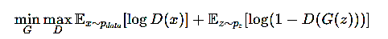
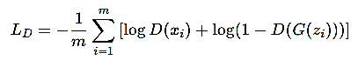
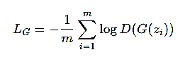
Mathematical Foundation of DCGAN
Adversarial Objective (same as GAN):
Discriminator Loss (binary cross-entropy):
Generator Loss:
The losses are computed over a mini-batch of size m

Slide 32

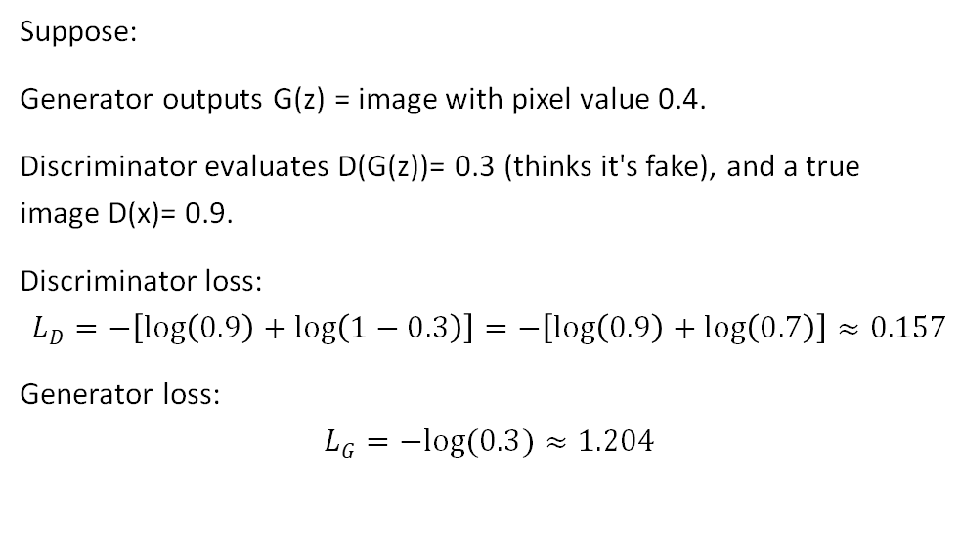
Example 1
Suppose:
Generator outputs G(z) = image with pixel value 0.4.
Discriminator evaluates D(G(z))= 0.3 (thinks it's fake), and a true image D(x)= 0.9.
Discriminator loss:
$$LD=−\left[\log\left(0.9\right)+\log\left(1−0.3\right)\right]=−\left[\log\left(0.9\right)+\log\left(0.7\right)\right]≈0.157$$
Generator loss:
$$LG=−log⁡(0.3)≈1.204$$

Slide 33
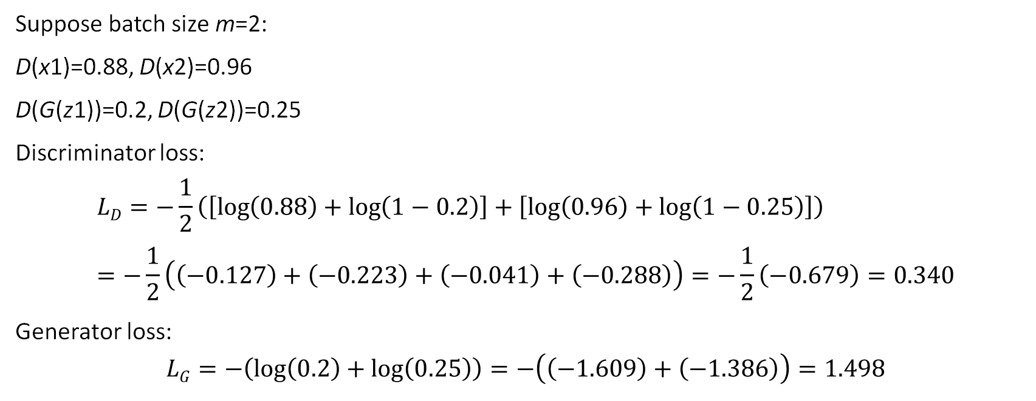
Example 2
Suppose batch size m=2:
D(x1)=0.88, D(x2)=0.96
D(G(z1))=0.2, D(G(z2))=0.25
Discriminator loss:
$$LD=−\frac{1}{2}\left(\left[\log\left(0.88\right)+\log\left(1−0.2\right)\right]+\left[\log\left(0.96\right)+\log\left(1−0.25\right)\right]\right)=−\frac{1}{2}\left(\left(−0.127\right)+\left(−0.223\right)+\left(−0.041\right)+\left(−0.288\right)\right)=−\frac{1}{2}\left(−0.679\right)=0.340$$
Generator loss:
$$LG=−\left(\log\left(0.2\right)+\log\left(0.25\right)\right)=−\left(\left(−1.609\right)+\left(−1.386\right)\right)=1.498$$

Slide 34
What is CycleGAN
The Challenge
How do we translate images across domains without corresponding paired examples?
Traditional Limitation
Supervised models require paired training data (x, y)
Example: Photo of zebra → exact same pose/lighting as horse
Problem: Such pairs are expensive, often impossible to obtain
CycleGAN Solution
Learns mappings between domains X and Y from unpaired data
No need for pixel-aligned (x, y) pairs
Bidirectional translation: G: X→Y and F: Y→X

Slide 35
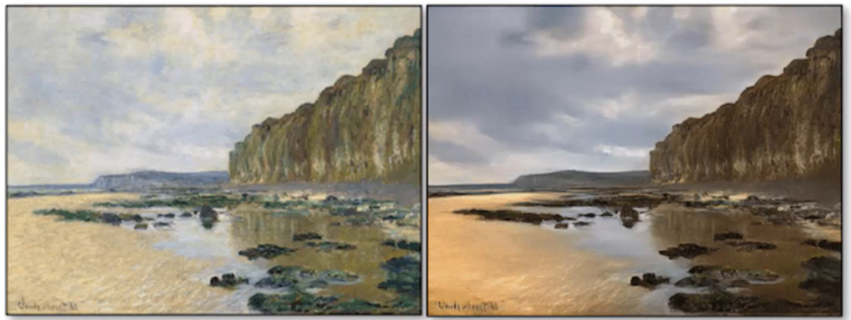
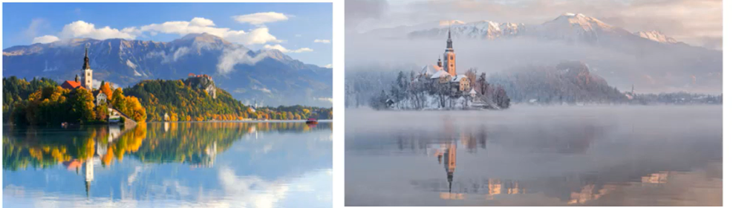
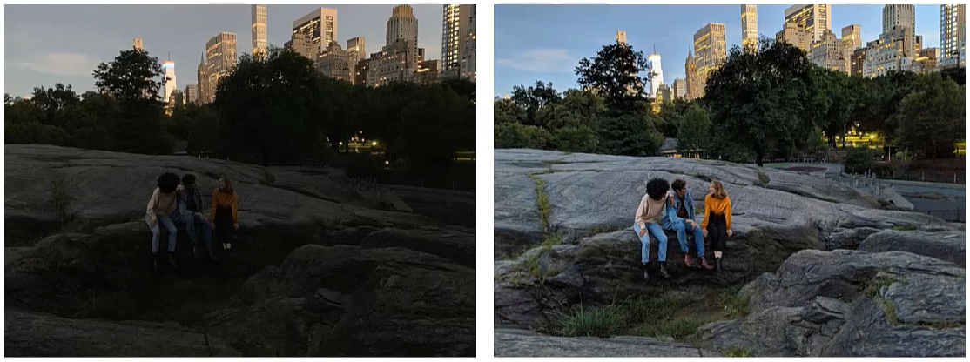
Real-World Applications
Paintings ↔ Photograph
Summer ↔ Winter scenes
Night
Day

Slide 36
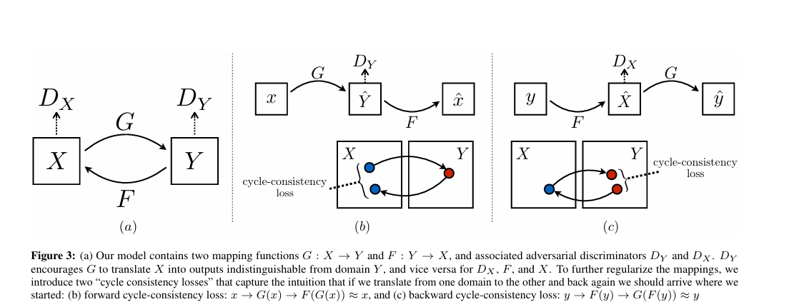
CycleGAN Architecture
Main Components:
Two Generators:
G:X→Y (e.g., photo → painting)
F:Y→X (e.g., painting → photo)
Two Discriminators:
D_{X}: Distinguishes real vs. fake in domain X
D_{Y}: Distinguishes real vs. fake in domain Y
Source: Unpaired Image-to-Image Translation using Cycle-Consistent Adversarial Networks

Slide 37
Forward and Backward Cycles
Forward Cycle: X → Y → X
Real image x from domain X
G translates: x → G(x) in domain Y
F reconstructs: G(x) → F(G(x)) ≈ x
Backward Cycle: Y → X → Y
Real image y from domain Y
F translates: y → F(y) in domain X
G reconstructs: F(y) → G(F(y)) ≈ y
Why Cycles Matter
→ Prevents mode collapse and arbitrary mappings → Ensures content preservation across translations

Slide 38
Loss Functions in CycleGAN
Adversarial loss:
Encourages realistic outputs in target domain
Applies to both (G, D_{Y}) and (F, D_{X})
Cycle consistency loss:
Enforces invertible mappings: F(G(x)) ≈ x and G(F(y)) ≈ y
Uses L1 norm to measure pixel-wise reconstruction error
Identity loss (optional):
Regularizes generators so G(y) ≈ y and F(x) ≈ x
Helps preserve colour, structure.

Slide 39
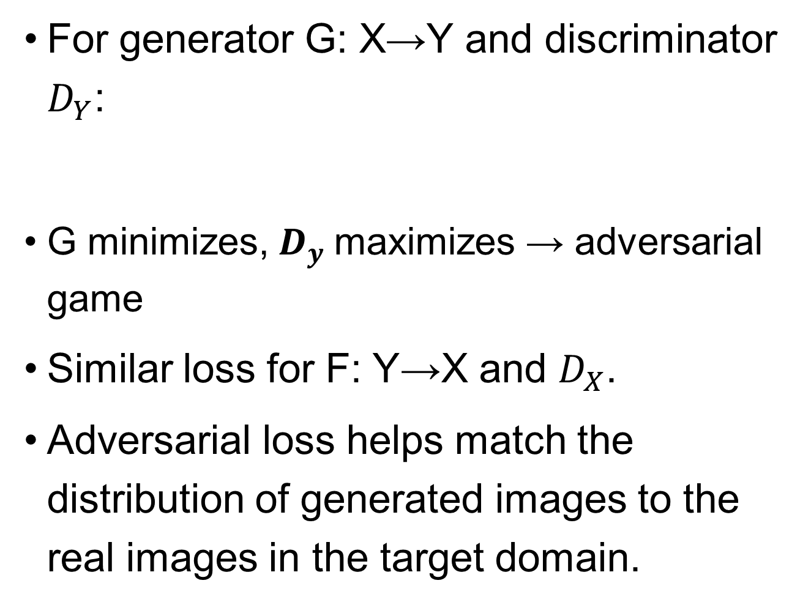
Adversarial Loss
For generator G: X→Y and discriminator $D_{Y}$:
G minimizes, $D_{y}$maximizes → adversarial game
Similar loss for F: Y→X and $D_{X}$.
Adversarial loss helps match the distribution of generated images to the real images in the target domain.
$$L_{ADV} (G,D_{y}) = E_{y}[log⁡D_{y}(y)] +E_{x}[log⁡(1 −D_{y}(G(x)))]$$

Slide 40
Cycle Consistency Loss
Enforces that an image mapped from its source to target and back returns to the original.
Forward Cycle Loss:
Backward Cycle Loss:
||·||₁ = L1 norm (pixel-wise difference)
Forces round-trip consistency
Prevents generators from trivially mapping all inputs to a constant output.
$$L_{CYC}(G, F) = E_{x}[||F(G(x)) − x||₁]$$
$$L_{CYC}(F, G) = E_{x}[||G(F(y)) −y||₁]$$

Slide 41
Identity Loss
Used when two domains share low-level features (e.g., color preservation):
Regularizes generators to retain content and color in translation tasks.
$$L_{IDT}(G, F) ={ E}_{y}[||F(G(y)) −y||₁]{+ E}_{x}[||F(G(x)) − x||₁]$$

Slide 42
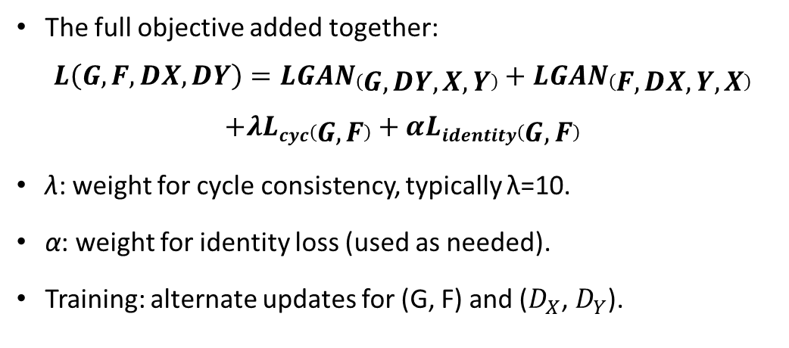
Combined Total Loss Function
The full objective added together:
$$L\left(G,F,DX,DY\right)=LGAN\left(G,DY,X,Y\right)+LGAN\left(F,DX,Y,X\right)$$
$$+λLcyc\left(G,F\right)+αLidentity\left(G,F\right)$$
λ: weight for cycle consistency, typically λ=10.
α: weight for identity loss (used as needed).
Training: alternate updates for (G, F) and ($D_{X}$, $D_{Y}$).

Slide 43
Detailed Network Architecture
Generators typically use residual blocks (ResNet) for better learning, sometimes skip connections (U-Net style).
Discriminators use PatchGAN (operates on N x N image patches, e.g., 70 x 70), outputting a probability map.
Data augmentation and normalization are standard (resize, crop, normalization to [-1, 1]).
Show a block diagram breaking down generator and discriminator internals.

Slide 44
Optimization & Training Details
Training alternates between updating generators (minimize total loss) and discriminators (maximize ability to distinguish real/fake).
Adam optimizer commonly used (learning rate ~ 0.0002).
Replay buffer may stabilize discriminator training by storing previously generated images.
Early stopping or model checkpoint based on validation loss.

Slide 45
Example
Suppose an input image x = 1.0 (representing a pixel intensity for simplicity).
Generator G predicts G(x) = 2.5. Generator F predicts F(G(x)) = 0.9.
Cycle consistency loss for this sample: ∣F(G(x))−x∣=∣0.9−1.0∣=0.1
In practice, this is summed over all image pixels and batch samples.

Slide 46
Motivation for Super-Resolution
Real-world need: enhance image formats for medical, satellite, streaming.
Deep learning methods outperform traditional interpolation (bicubic, etc.)

Slide 47
SISR Problem Statement
Input: Low-res image I_{LR}
Output: High-res image I_{SR}
Goal: I_{SR}≈I_{HR} (visually and/or pixelwise)
Why is this hard? Many possible HR images for one LR image.

Slide 48

SRGAN
Use GANs to make upsampled images perceptually realistic
Generator upsamples input LR images
Discriminator learns to distinguish generated SR from real HR images
Perceptual (VGG-based) loss for sharper details

Slide 49
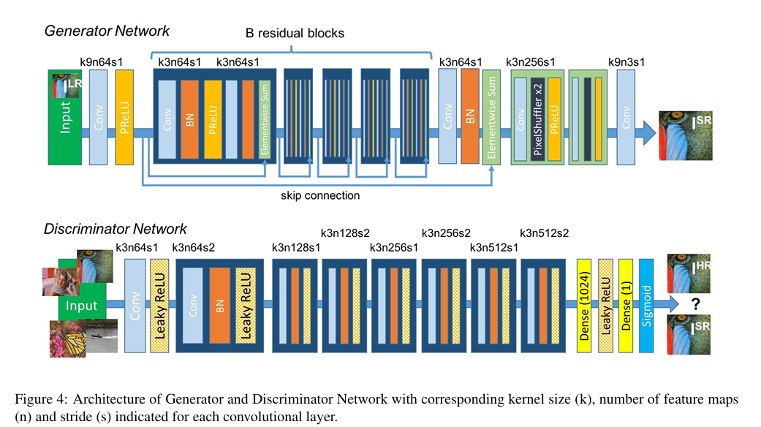
SRGAN Architecture
Source: Photo-Realistic Single Image Super-Resolution Using a Generative Adversarial Network

Slide 50
SRGAN Architecture (Cont.)
Two main modules: Generator and Discriminator
Generator: Upscales LR images
Discriminator: Distinguishes real SR from fake SR

Slide 51
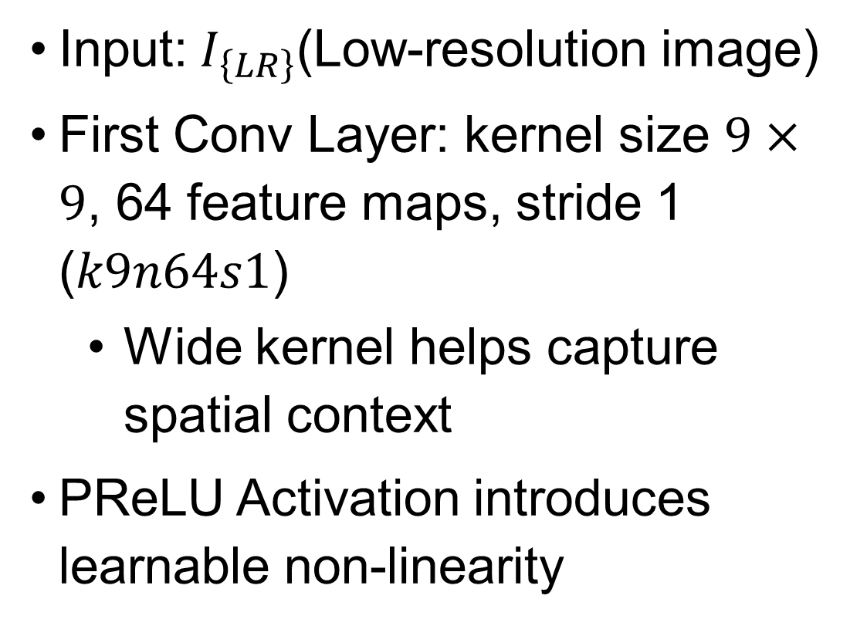
Generator Network — Input and First Layers
Input:$I_{\left\{LR\right\}}$(Low-resolution image)
First Conv Layer: kernel size $9×9$, 64 feature maps, stride 1 ($k9n64s1$)
Wide kernel helps capture spatial context
PReLU Activation introduces learnable non-linearity

Slide 52
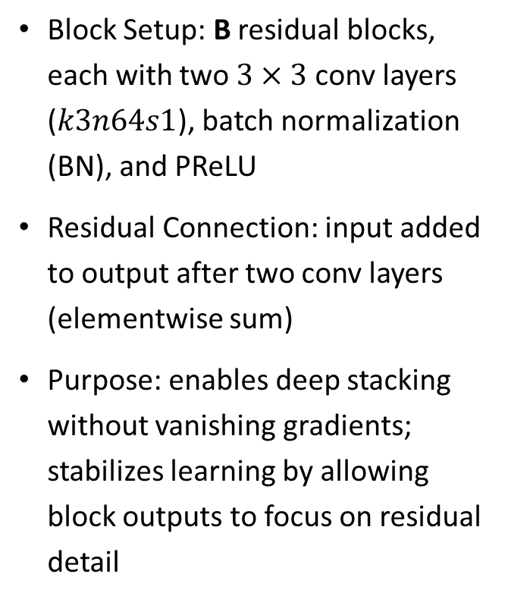
Generator — Residual Blocks Core (Block-by-Block)
Block Setup: B residual blocks, each with two $3×3$conv layers ($k3n64s1$), batch normalization (BN), and PReLU
Residual Connection: input added to output after two conv layers (elementwise sum)
Purpose: enables deep stacking without vanishing gradients; stabilizes learning by allowing block outputs to focus on residual detail

Slide 53
Generator — Residual Block Details
Intra-block structure: Conv → BN → PReLU → Conv → BN → Elementwise Sum
Skip Connection: allows information from earlier layers to flow straight to deeper layers
Benefit: promotes effective feature reuse, improves image sharpness

Slide 54
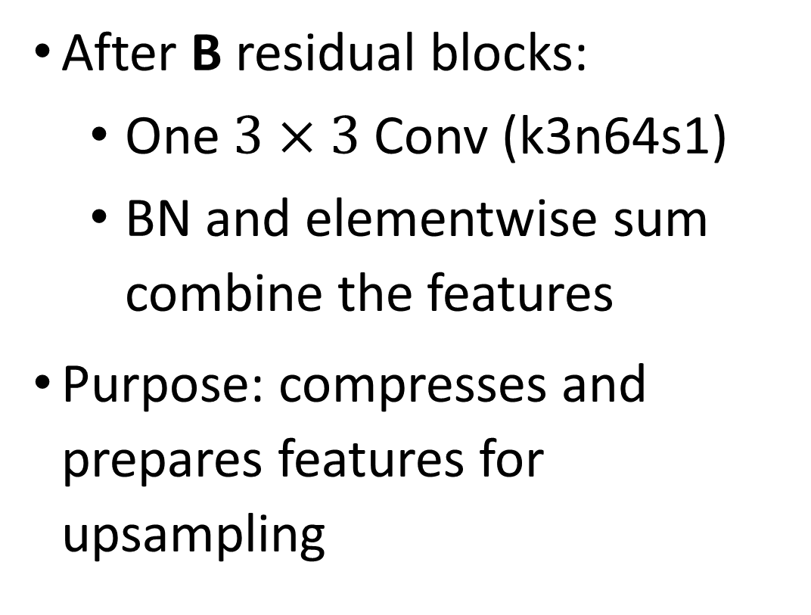
Generator — Post-Residual Processing
After B residual blocks:
One $3×3$Conv (k3n64s1)
BN and elementwise sum combine the features
Purpose: compresses and prepares features for upsampling

Slide 55
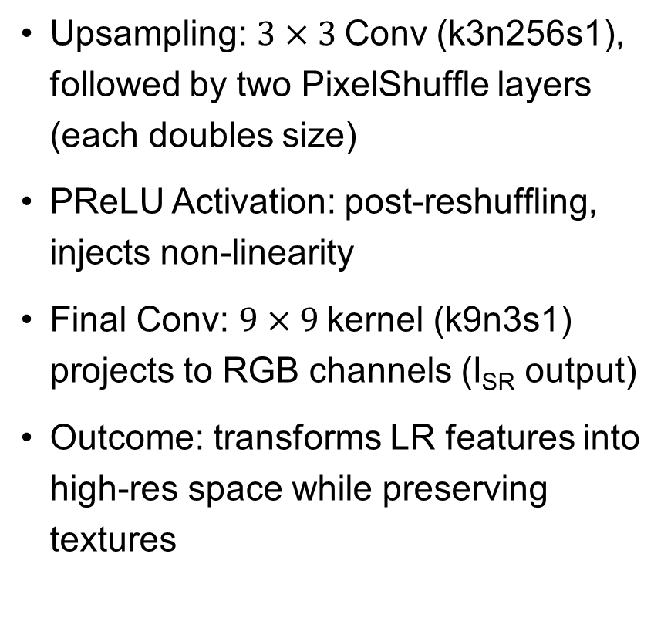
Generator — Upsampling and Output Layers
Upsampling: $3×3$Conv (k3n256s1), followed by two PixelShuffle layers (each doubles size)
PReLU Activation: post-reshuffling, injects non-linearity
Final Conv: $9×9$kernel (k9n3s1) projects to RGB channels (I_{SR} output)
Outcome: transforms LR features into high-res space while preserving textures

Slide 56
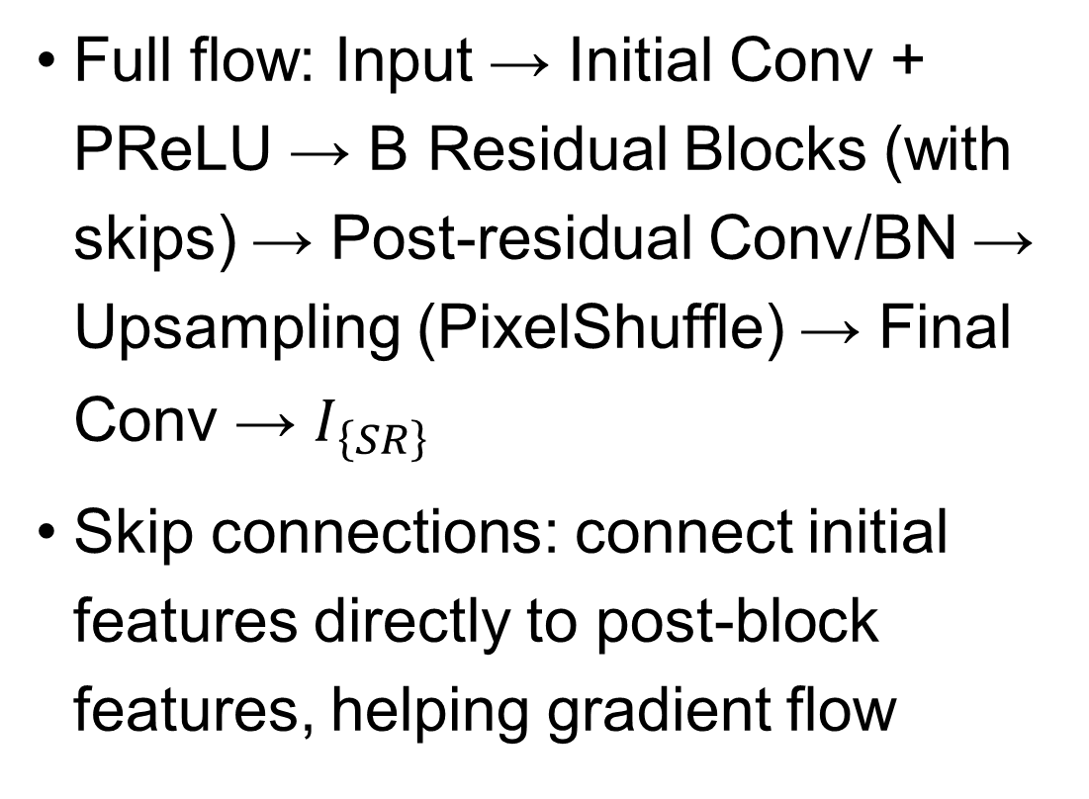
Generator — Full Data Flow & Connections
Full flow: Input → Initial Conv + PReLU → B Residual Blocks (with skips) → Post-residual Conv/BN → Upsampling (PixelShuffle) → Final Conv → $I_{\left\{SR\right\}}$
Skip connections: connect initial features directly to post-block features, helping gradient flow

Slide 57
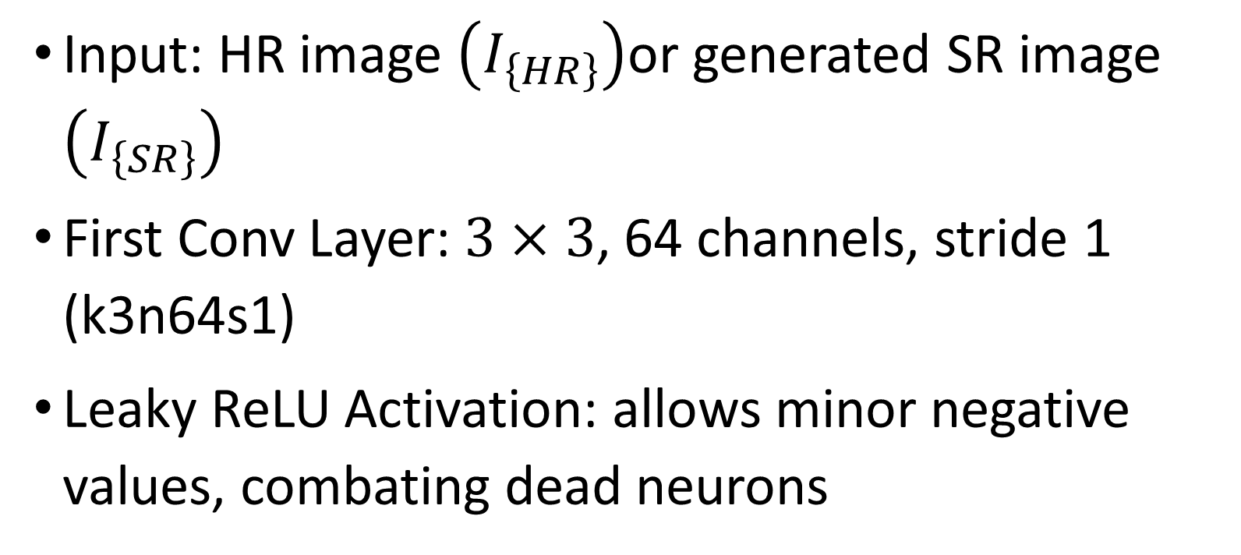
Discriminator Network — Input and Early Layers
Input: HR image $\left(I_{\left\{HR\right\}}\right)$or generated SR image $\left(I_{\left\{SR\right\}}\right)$
First Conv Layer: $3×3$, 64 channels, stride 1 (k3n64s1)
Leaky ReLU Activation: allows minor negative values, combating dead neurons

Slide 58
Discriminator — Progressive Feature Expansion
Increasing Depth:
Conv (k3n64s2), BN, Leaky ReLU
Conv (k3n128s1), BN, Leaky ReLU
Conv (k3n128s2)... progresses to k3n256, k3n512 layers
Purpose: deeper layers extract hierarchical detail, stride>1 reduces spatial dimensions

Slide 59
Discriminator — Transition to Fully-Connected (Dense) Layers
Flatten output and apply Dense(1024) layer
Leaky ReLU on Dense layer
Final Dense(1) output: single scalar representing "realness"
Sigmoid Activation: produces output in, interpreted as probability

Slide 60
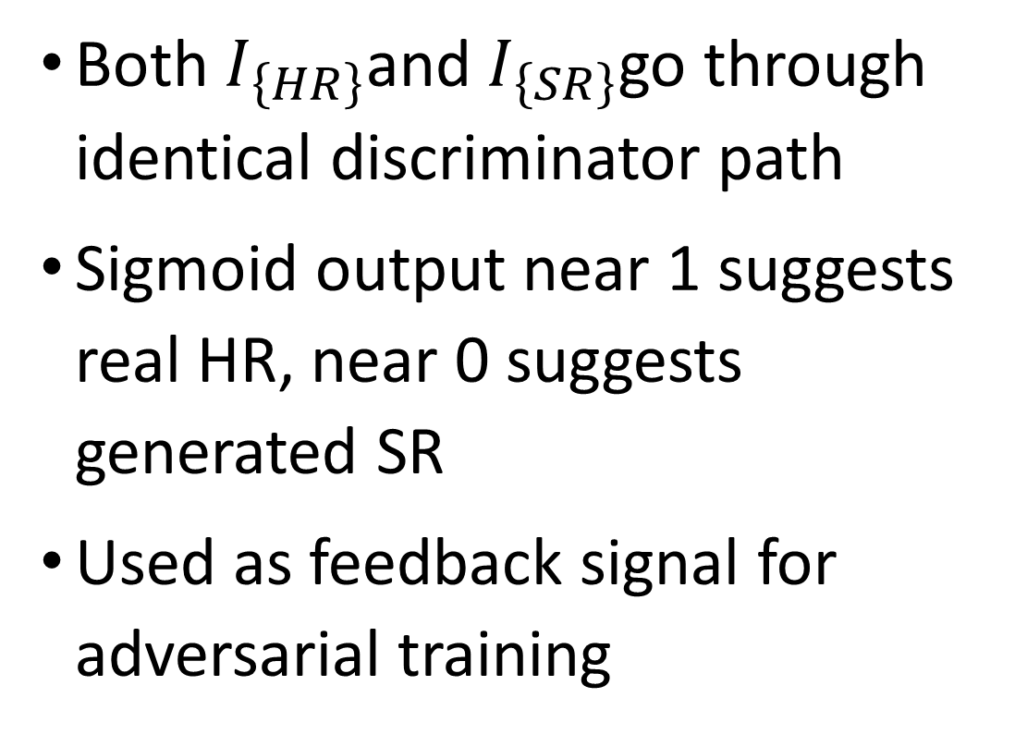
Discriminator — Real vs. Fake Decision
Both $I_{\left\{HR\right\}}$and $I_{\left\{SR\right\}}$go through identical discriminator path
Sigmoid output near 1 suggests real HR, near 0 suggests generated SR
Used as feedback signal for adversarial training

Slide 61
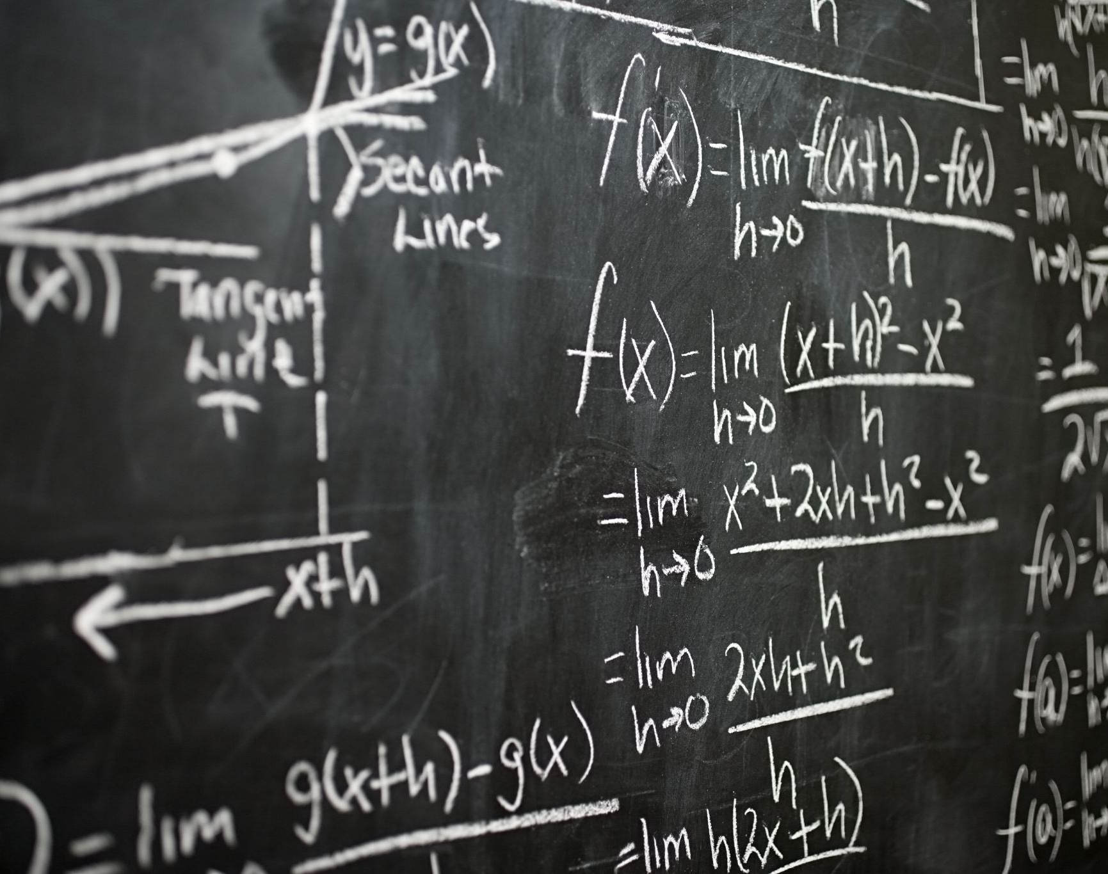
Mathematical Formulation
Residual Block Formula:
Y = x+F(x,Wi)
where F(x,Wi) is the stacked BN, activation, conv layers
PixelShuffle Layer: learns upsampling using channel rearrangement, avoids interpolation artifacts

Slide 62

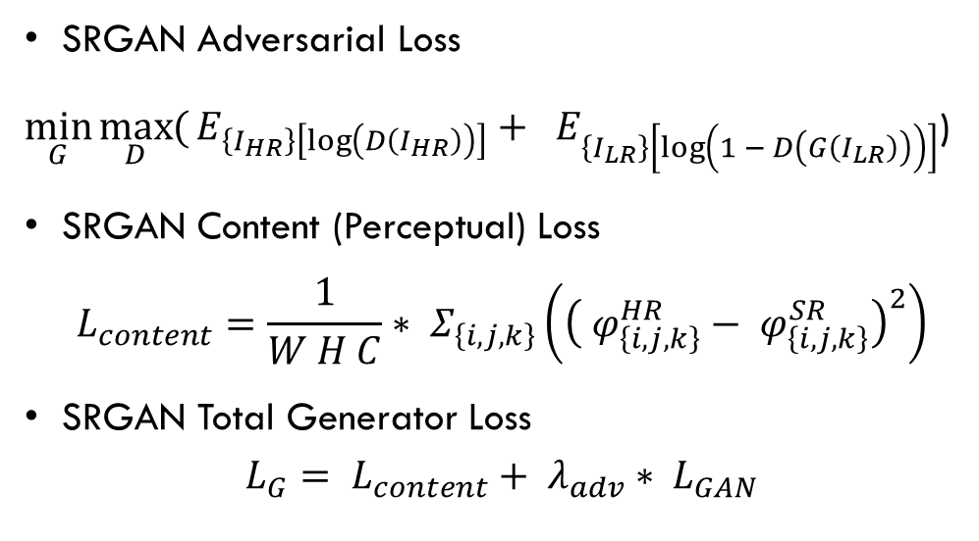
Loss Functions
SRGAN Adversarial Loss
$\min_{G}{\max_{D}{(}E_{\left\{I_{HR}\right\}\left[\log\left(D\left(I_{HR}\right)\right)\right]}}+ E_{\left\{I_{LR}\right\}\left[\log\left(1 − D\left(G\left(I_{LR}\right)\right)\right)\right]}$)
SRGAN Content (Perceptual) Loss
$$L_{content}=\frac{1}{W H C}∗ Σ_{\left\{i,j,k\right\}}\left({\left( φ_{\left\{i,j,k\right\}}^{HR}− φ_{\left\{i,j,k\right\}}^{SR}\right)}^{2}\right)$$
SRGAN Total Generator Loss
$$L_{G}= L_{content}+ λ_{adv}∗ L_{GAN}$$

Slide 63
SRGAN—Limitations and the Need for ESRGAN
SRGAN can introduce artifacts or lose textures
1
Critical hyperparameters: number of residual blocks, batch size, VGG feature layer
2
Motivation for ESRGAN: improved texture recovery, fewer artifacts
3

Slide 64
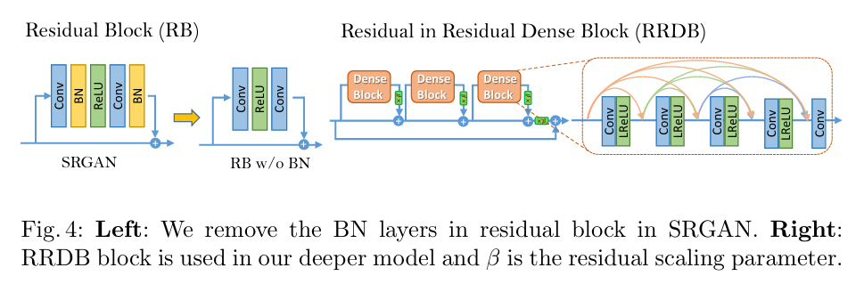
Architecture diagram
Source: ESRGAN: Enhanced Super-Resolution Generative Adversarial Networks

Slide 65
SRGAN Residual Block (RB)
Residual Block (RB) structure in SRGAN:
Sequential layers: Conv → Batch Normalization (BN) → ReLU → Conv → BN
Output of last BN is added elementwise to input (skip connection)
Role of each layer:
Conv layers learn features
BN normalizes activations, speeding up training (but see next)
ReLU injects non-linearity
Purpose: Helps network be deep while avoiding vanishing gradients. Facilitates better feature reuse.

Slide 66
Removing BN in Residual Blocks (RB w/o BN)
ESRGAN modification: Removes BN layers from RBs.
New structure: Conv → ReLU → Conv
Why?
BN sometimes causes artifacts and restricts expressive power for SR
Removing BN stabilizes and improves performance, especially at high upscaling
Effect: Simpler and visually sharper results. Used as the basis for deeper blocks in ESRGAN.

Slide 67
RRDB—Residual in Residual Dense Block
What is RRDB?
An RRDB stacks several Dense Blocks inside a main residual block (skip connections at multiple scales)
Uses no BN layers—only Conv and LeakyReLU
Deep skip connections help propagate both local and global features
Each Dense Block itself has multiple Conv+LeakyReLU units, with every output fed forward to all subsequent layers (dense connectivity)

Slide 68
RRDB—Residual in Residual Dense Block (Cont.)
Residual Scaling (ββ)
Output of RRDB is scaled by a parameter ββ (e.g., 0.2) before being added to input
This prevents exploding gradients in very deep stacks
Equation (for nn RRDBs): x_{out}=x_{in}+β⋅F_{RRDB}(x_{in}) where F_{RRDB} includes all inner Dense Blocks and skips

Slide 69
From SRGAN RB to ESRGAN RRDB
SRGAN: RB = Conv → BN → ReLU → Conv → BN + skip connection
ESRGAN:
Removes BN (Conv → ReLU → Conv), enabling deeper networks without instability
RRDB (Residual-in-Residual Dense Block): stacks Dense Blocks, multiplies output by β, then adds skip
Dense Blocks: every Conv layer output is connected to all layers ahead in that block
More effective for texture/detail restoration

Slide 70
Practical Impact of Block Changes
SRGAN RBs: Easy to train, but less effective at very high scales and for fine textures
ESRGAN RRDBs: Supports deeper/wider networks, captures more detail, avoids BN-induced artifacts (color shift/instability)
Why important? These changes directly contribute to ESRGAN outperforming SRGAN on metrics and in visual fidelity for super-resolution tasks.

Slide 71
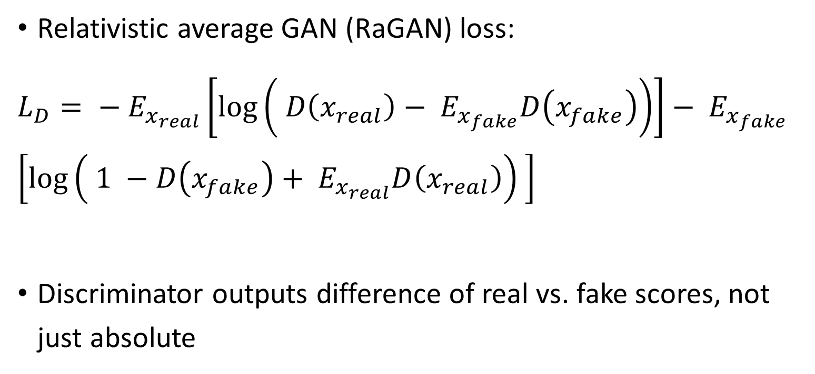
Relativistic Discriminator
Relativistic average GAN (RaGAN) loss:
$L_{D}= − E_{x_{real}}\left[\log\left( D\left(x_{real}\right)− E_{x_{fake}}D\left(x_{fake}\right)\right)\right]− E_{x_{fake }}$ $\left[\log\left( 1 −D\left(x_{fake}\right)+ E_{x_{real}}D\left(x_{real}\right)\right) \right]$
Discriminator outputs difference of real vs. fake scores, not just absolute

Slide 72
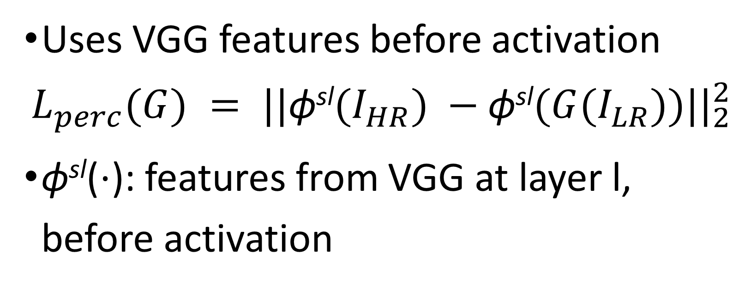
ESRGAN—Perceptual Loss
Uses VGG features before activation
$$L_{perc}(G) = ||\text{ϕ}\text{sl}(I_{HR}) −\text{ϕ}\text{sl}(G(I_{LR}))||_{2}^{2}$$
ϕ^{sl}(⋅): features from VGG at layer l, before activation

Slide 73
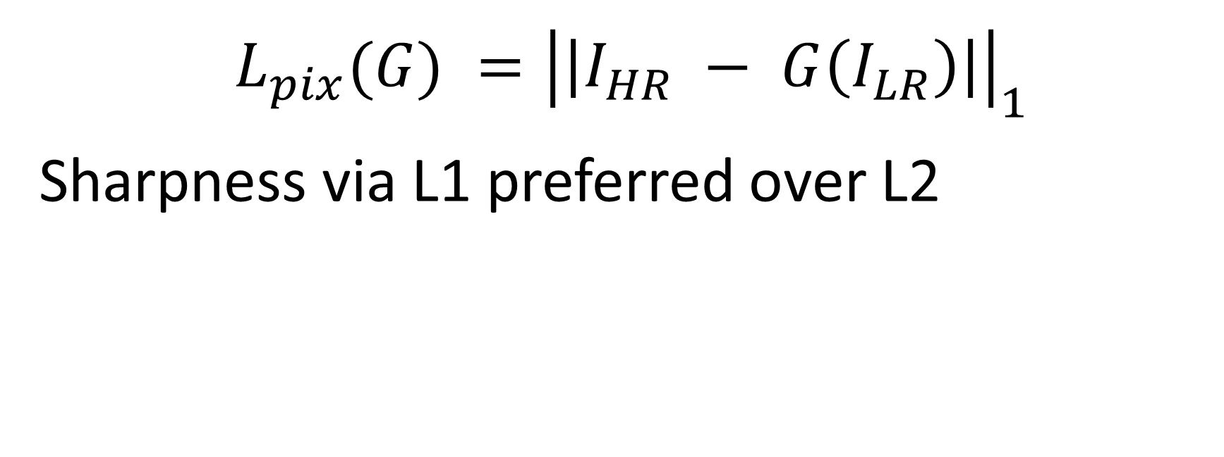
ESRGAN—Pixel-wise Loss
$$L_{pix}(G) ={\left|\left|I_{HR} − G\left(I_{LR}\right)\right|\right|}_{1}$$
Sharpness via L1 preferred over L2

Slide 74
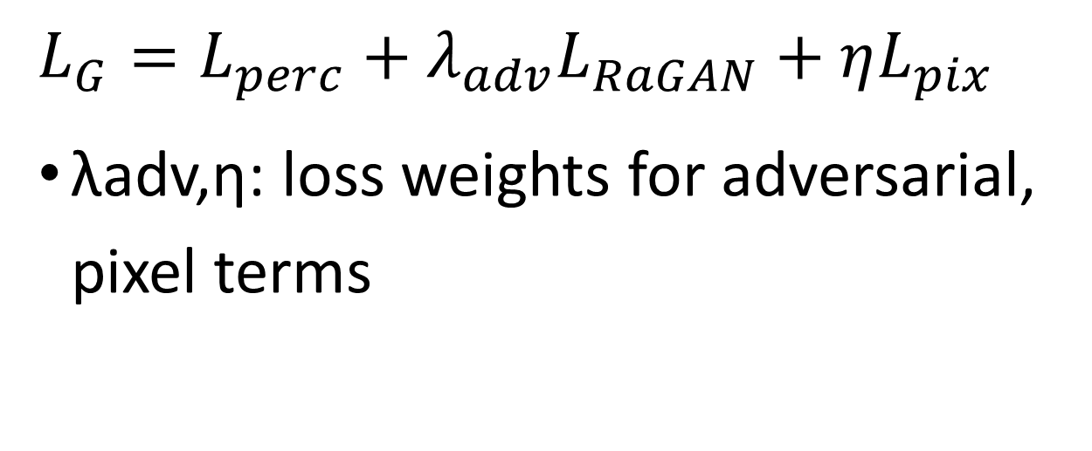
ESRGAN—Total Generator Loss
$L_{G}=L_{perc}+λ_{adv}L_{RaGAN}+ηL_{pix}$
λadv,η: loss weights for adversarial, pixel terms

Slide 75
ESRGAN Training Strategy
Warm-up phase: only pixel and perceptual losses
Full ESRGAN: add adversarial (RaGAN) loss after stabilization
Adam optimizer: lr=2e−4lr=2e−4
Large batch sizes, lots of data augmentation
Training challenges: memory usage increases with deeper RRDB stacks

Slide 76
ESRGAN Visual Outputs & Performance
Examples: bicubic vs SRGAN vs ESRGAN image patches
ESRGAN produces sharper edges, more realistic textures, fewer artifacts
State-of-the-art PSNR, SSIM, and LPIPS scores on common datasets

Slide 77
Advanced ESRGAN Variants
Real-ESRGAN: Use synthetic degraded images, better handles real-world low-res images
MSA-ESRGAN: Multi-scale attention U-Net discriminator for richer feature fusion [see Nature, Nov. 2024]​
Channel/Spatial Attention Fusing Module (see formulas in ):​
CAM: Emphasizes/weights important features across channels
SAM: Highlights spatially relevant regions using pooling and convolutions

Slide 78
References
Goodfellow, I., Pouget-Abadie, J., Mirza, M., Xu, B., Warde-Farley, D., Ozair, S., Courville, A. and Bengio, Y., 2020. Generative adversarial networks. Communications of the ACM, 63(11), pp.139-144.
Radford, A., Metz, L. and Chintala, S., 2015. Unsupervised representation learning with deep convolutional generative adversarial networks. arXiv preprint arXiv:1511.06434.
Zhu, J.Y., Park, T., Isola, P. and Efros, A.A., 2017. Unpaired image-to-image translation using cycle-consistent adversarial networks. In Proceedings of the IEEE international conference on computer vision (pp. 2223-2232).
Ledig, C., Theis, L., Huszár, F., Caballero, J., Cunningham, A., Acosta, A., Aitken, A., Tejani, A., Totz, J., Wang, Z. and Shi, W., 2017. Photo-realistic single image super-resolution using a generative adversarial network. In Proceedings of the IEEE conference on computer vision and pattern recognition (pp. 4681-4690).
Wang, X., Yu, K., Wu, S., Gu, J., Liu, Y., Dong, C., Qiao, Y. and Change Loy, C., 2018. Esrgan: Enhanced super-resolution generative adversarial networks. In Proceedings of the European conference on computer vision (ECCV) workshops (pp. 0-0).

Slide 79
Thank You
Name | Roll No. | Contribution
Saba Akram | 2422CS15 | 2.7%
Ranjesh Kumar Roy | 2521MA01 | 2.7%
Ashish Rao | 2521CS11 | 2.7%
Srijan Ghosh | 2521CS05 | 2.7%
Rachna Mahawar | 2521CS06 | 2.7%
Priyanka Sarkar | 2521CS14 | 2.7%
Shivam Kumar | 2521CS04 | 2.7%
Kamakhya Mishra | 2521CS01 | 2.7%
Ganesh Kumar | 2521EE11 | 2.7%
Shalini Singh | 2521CS21 | 2.7%
Gunja Kumari | 2521CS15 | 2.7%
Bipul Kumar | 2422CS23 | 2.7%
Ashwani | 2521CS17 | 2.7%
Mehar Keshvendra Singh | 2422CS07 | 2.7%
Abhishek Kumar Pandey | 2422CS16 | 2.7%
Deeksha Chaudhary | 2422CS19 | 2.7%
Irfan Khan | 2421CS31 | 2.7%
Deepak Kumar | 2521CS20 | 2.7%
Shubham Anand | 2422CS22 | 2.7%
Name | Roll No. | Contribution
Bibek Das | 2422CS27 | 2.7%
Aditya Kumar | 2521CS10 | 2.7%
Sandhya Kumari | 2521CS28 | 2.7%
Kriti Kumari | 2521CS27 | 2.7%
Madiha Tariq | 2521CS33 | 2.7%
Kamala Kant Yadav | 2521CS02 | 2.7%
Raju Debnath | 2521CS03 | 2.7%
Raj Ratna | 2521CS16 | 2.7%
Gaurav Kumar | 2521CS29 | 2.7%
Sanjib Chowdhury | 2521CS13 | 2.7%
Nitesh Kumar | 2421EE24 | 2.7%
Paritosh Kumar | 2521CS12 | 2.7%
Nairita Das | 2422EE05 | 2.7%
Sanaya Malik | 2422CS14 | 2.7%
Suriyaprasad B | 2421ME11 | 2.7%
Vikas Kumar Keshari | 2422EE04 | 2.7%
Soumya Majumdar | 2422CS11 | 2.7%
Radhey Shyam | 2521CS09 | 2.7%

